Slide 1
BMED 4699, Mahdi Al-Husseini
Emory Center for Mathematics and Computing in Medicine E(CM)²

Slide 2
Fall Semester Plan
Develop a Fundamental Understanding of Finite Element Methods and Review Navier-Stokes Formulations
Develop MATLAB Pre-Processor and Processor Files that take in Patient Specific IVC/SVC/PA Measurements from Dr. Anthony Corto, and output Constructive Geometry Mesh Files
Identify Relevant Boundary Conditions for the Fontan Procedure from the Academic Literature
Develop C++ Navier-Stokes Solver (.edp file) and specify Boundary Conditions in NetGen

Slide 3
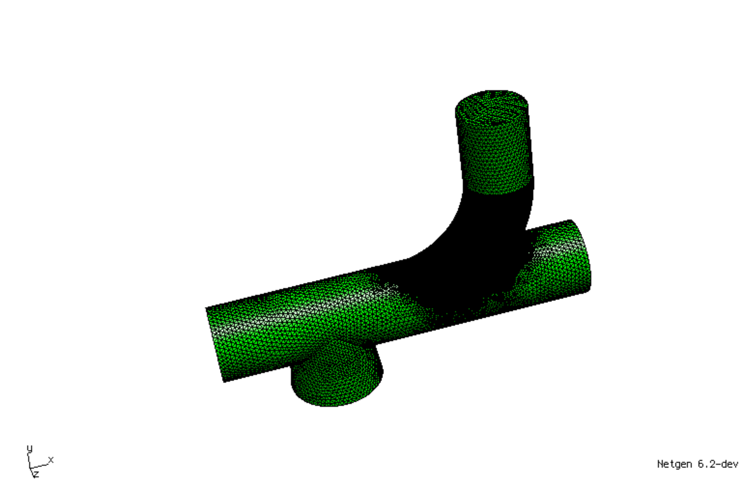
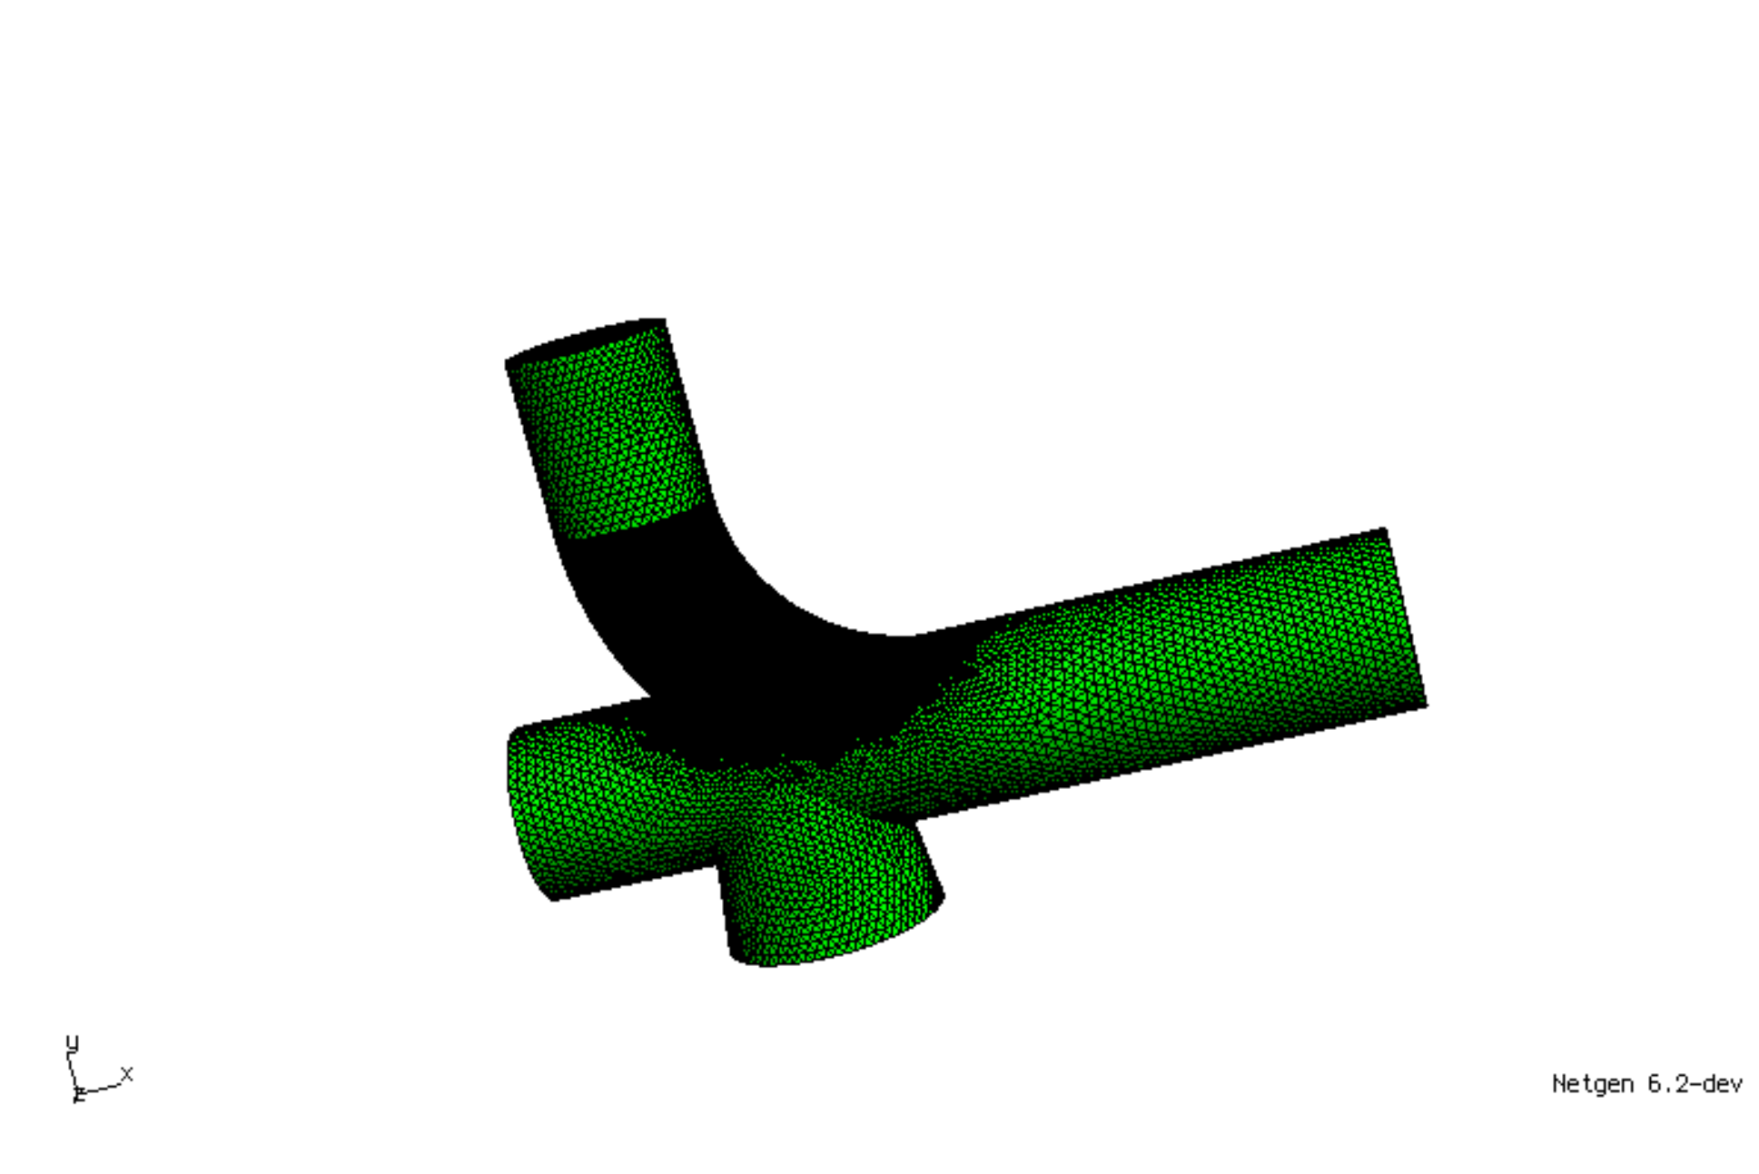
CONSTRUCTIVE GEOMETRY MESH FILES
Modified
Fontan

Slide 4
Identified Boundary Conditions of Note

Slide 5
Spring Semester Plan
Finalize C++ Navier-Stokes Solver (.edp file) and specify Boundary Conditions in NetGen
Visualize in ParaView
If Significant Difference Detected between Fontan and Modified Fontan:
Begin Developing Patient-Specific Mesh using CT Scan
Reapply Navier-Stokes Solver to both Models
Write-up and Publish Results

